Slide 1

REAL TIME PROJECT PRESENTATION
ON
Hyperfit AI:your smart,adaptive and always evolving personal trainer
23R21A6697-K.VAISHNAVI
23R21A6691-J.SNEHA
23R21A66B2-P.MOHANA
23R21A6688-G.PURI JAGANNATH
Under the guidance of
MR P.BABU
Assistant Professor
Department of Computer Science & Engineering-Artificial Intelligence and Machine Learning

Slide 2

OVERVIEW
Abstract
Introduction
Existing Systems
Challenges Of Existing Systems
Literature Survey
Proposed System
Objectives
System Requirements
System Architecture
UML Diagrams
Implementation(Sample code)
Output
Conclusion
Future Enhancements
References

Slide 3
ABSTRACT
A Personal AI Gym Trainer uses AI,computer vision, and machine learning to deliver real-time,personalised fitness coachin.It analyzes movements via pose estimation to ensure proper form and prevent injuries.NLP enables voice interaction, while aI tailors workout plans based on progess and goals. Cloud storage allows easy access across devices,with mobile/web apps for tracking.Advanced analytics offer performance insights, and optional AR/VR adds immersive experiences.This smart trainer makes professional guidance more accessible,affordable,and effective for all fitness levels.

Slide 4
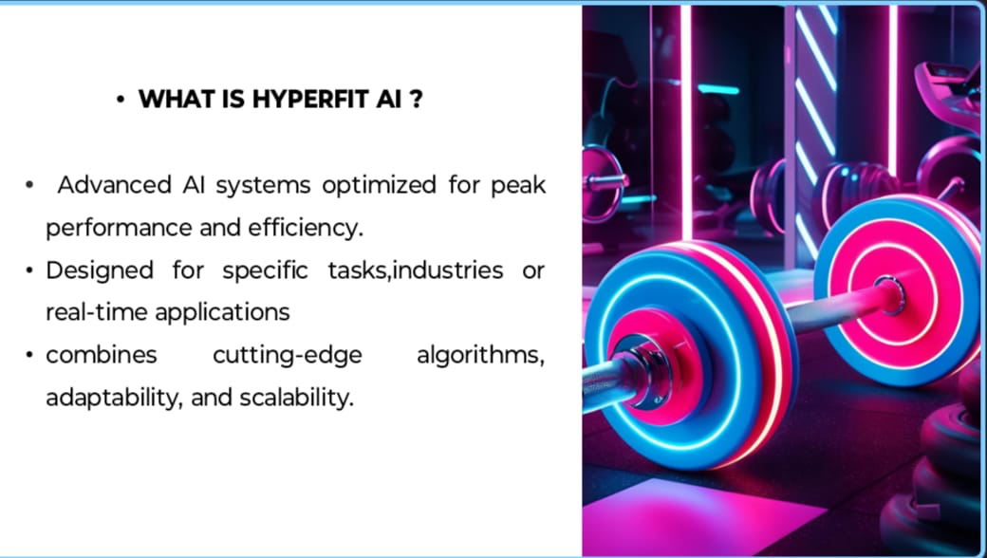
INTRODUCTION

Slide 5
EXISITING SYSTEMS OF HYPERFIT AI
1.Fitbit & Google Fit
Functionality: Track steps, heart rate, sleep, and calories using wearable sensors.
AI Use: Offers insights and health trends using simple data analytics.
2. MyFitnessPal
Functionality: Calorie tracking, diet planning, and weight management.
AI Use: Uses historical data to make food recommendations.
3. Freeletics & Nike Training Club
Functionality: Provide guided workouts with visual coaching.
AI Use: Adaptive workout plans based on user feedback and progress.
4. Cure.fit (Cult.fit)
Functionality: Offers digital and in-person fitness training, mental wellness, and diet planning.

Slide 6
CHALLENGES OF EXISTING SYSTEMS
Limited Personalization
Most current apps offer generic plans or basic customization.
Lack of deep AI-driven adaptation based on user performance, progress, and preferences.
No Real-Time Feedback
Systems like Fitbit, MyFitnessPal, and Freeletics don’t provide instant feedback on exercise form or breathing techniques.
Risk of injury due to incorrect posture or movements goes unnoticed.
Manual Data Entry
Nutrition and activity tracking apps often require manual input, which can be time-consuming and prone to errors or skipped entries.
Fragmented Ecosystems
Users often need multiple apps for fitness, diet, sleep, and mental health.
No unified platform providing a holistic wellness solution.

Slide 7
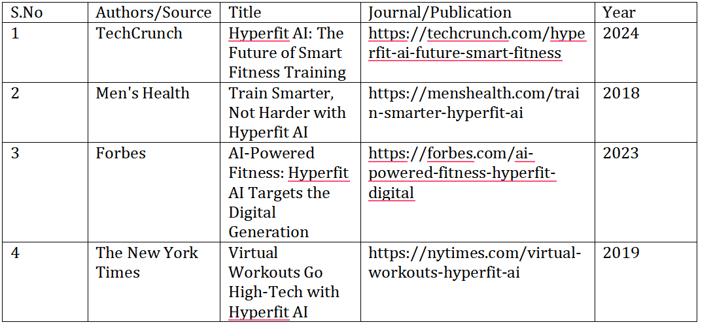
LITERATURE SURVEY

Slide 8
PROPOSED SYSTEM
The increasing demand for health, fitness, and home-based exercise routines has created a need for intelligent systems that can monitor and guide users without the presence of a human trainer. Traditional fitness methods often lack real-time feedback, which may lead to incorrect postures and potential injuries. Moreover, access to professional coaching or physiotherapy may not always be affordable or available.The proposed HyperFit AI system addresses these challenges by offering a cost-effective, real-time pose detection solution using readily available hardware like a webcam and open-source libraries like MediaPipe and OpenCV. These tools enable accurate detection of body landmarks and postural alignment with minimal computational resources.

Slide 9
OBJECTIVES
Personalized Workout Plans
AI analyzes fitness goals, body metrics, and performance data.
Generates tailored exercise routines for optimal results.
Real-Time Performance Tracking
Wearable devices with AI monitor heart rate, calories burned.
Provides instant feedback and adjustments during workouts.
Nutrition Guidance
Creates customized meal plans based on dietary needs & fitness goals
Tracks macronutrient intake and suggests adjustments.
Injury Prevention
Analyzes movement patterns to detect improper form or risk of injury.

Slide 10
System Requirements
HARDWARE REQUIREMENTS
Development Stage:
CPU: Intel Core i5 or AMD Ryzen 5
(Recommended: Intel Core i7 or AMD Ryzen 7)
RAM: Minimum 8 GB
(Recommended: 16 GB or more for smoother real-time processing)
Storage: 256 GB SSD
(Faster read/write speeds for image and model processing)
GPU (Optional): For future AI enhancements, NVIDIA GeForce GTX/RTX series with CUDA support

Slide 11
SOFTWARE REQUIREMENTS:
Frontend: React.js, Vite, Tailwind CSS
Backend Framework: Express.js, Node.js, TypeScript
Database: Firebase (Authentication + Firestore)
Development Tools: VS Code, GitHub, Curso
System Requirements

Slide 12
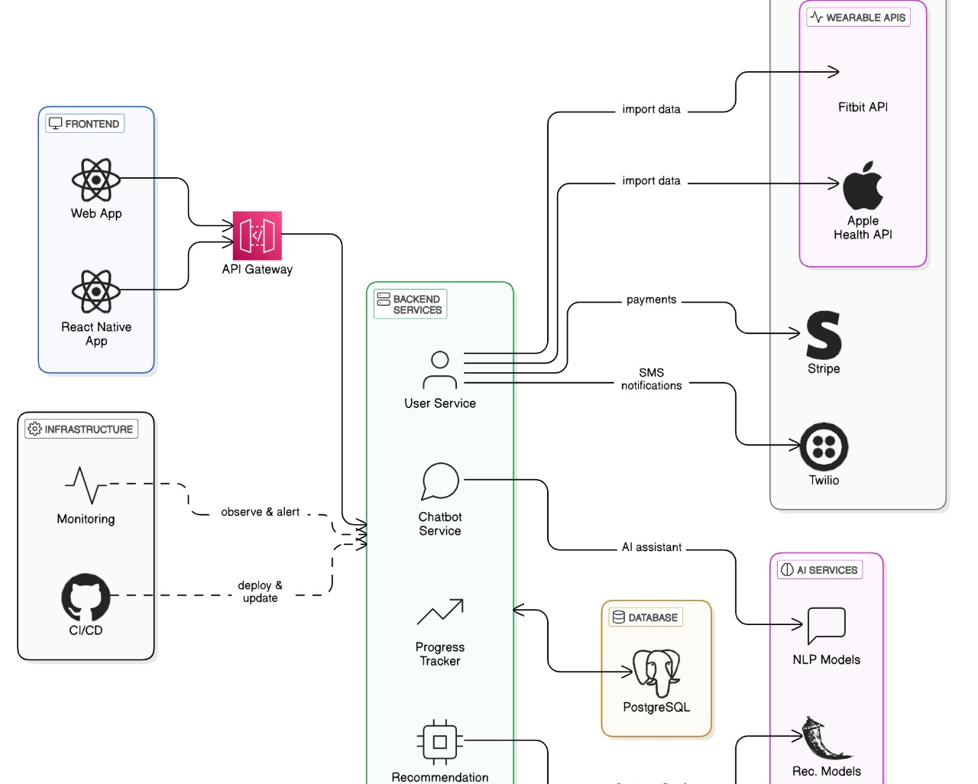
SYSTEM ARCHITECTURE

Slide 13
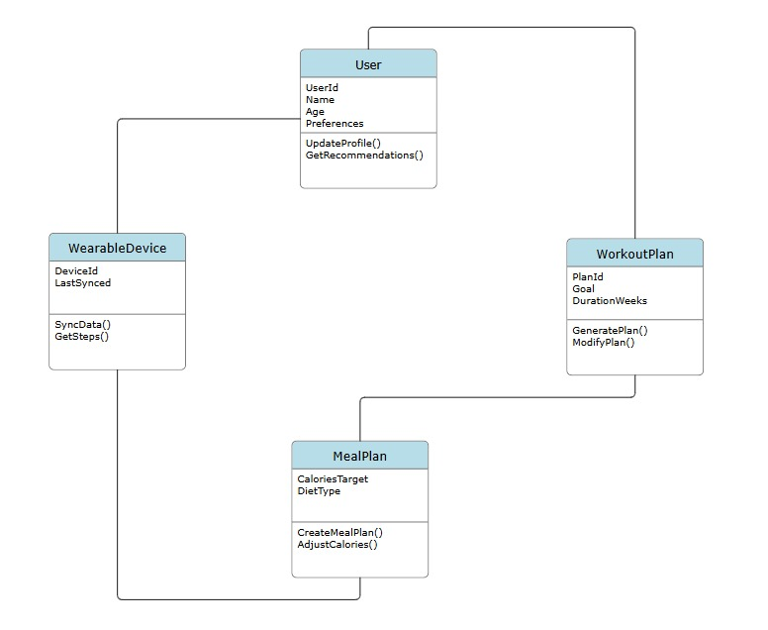
CLASS DIAGRAM

Slide 14
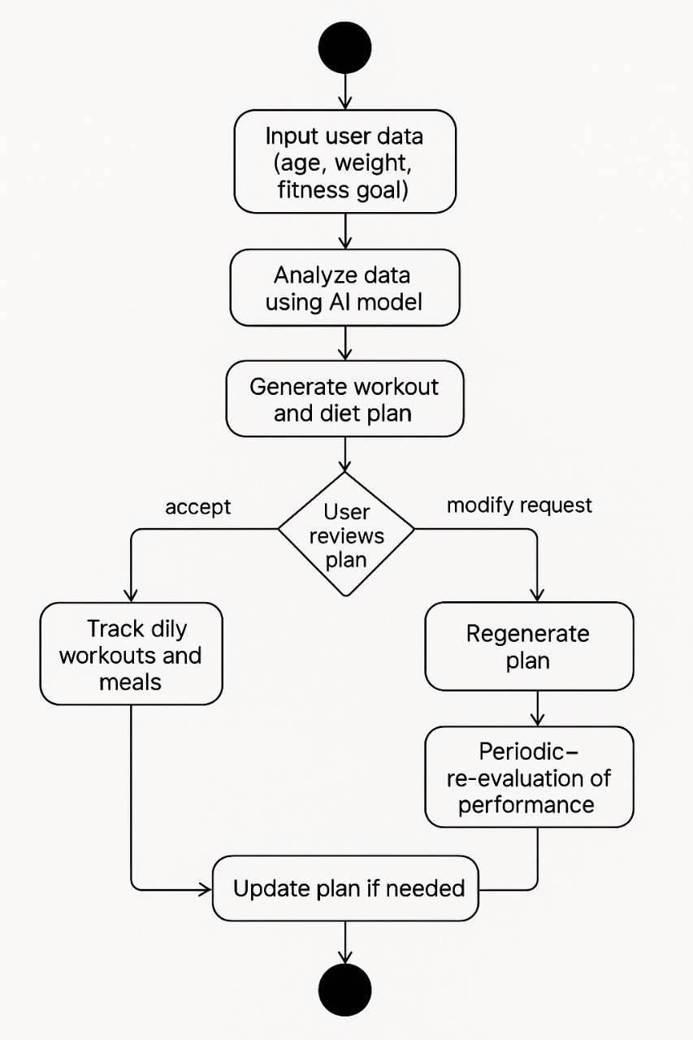
ACTIVITY DIGRAM

Slide 15
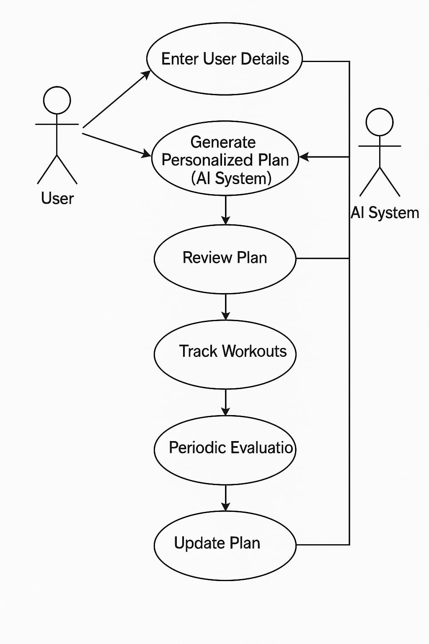
USE CASE DIAGRAM

Slide 16
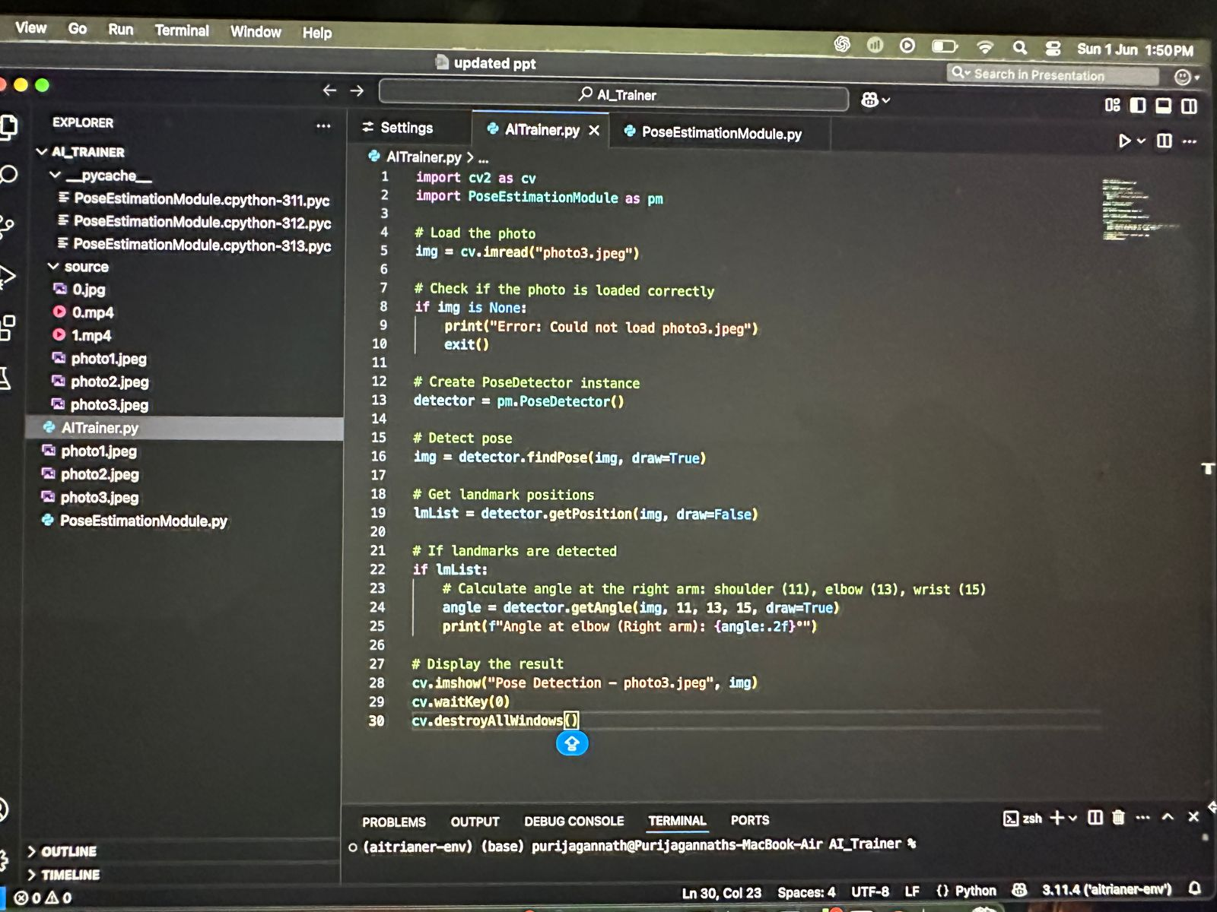
Sample Code

Slide 17
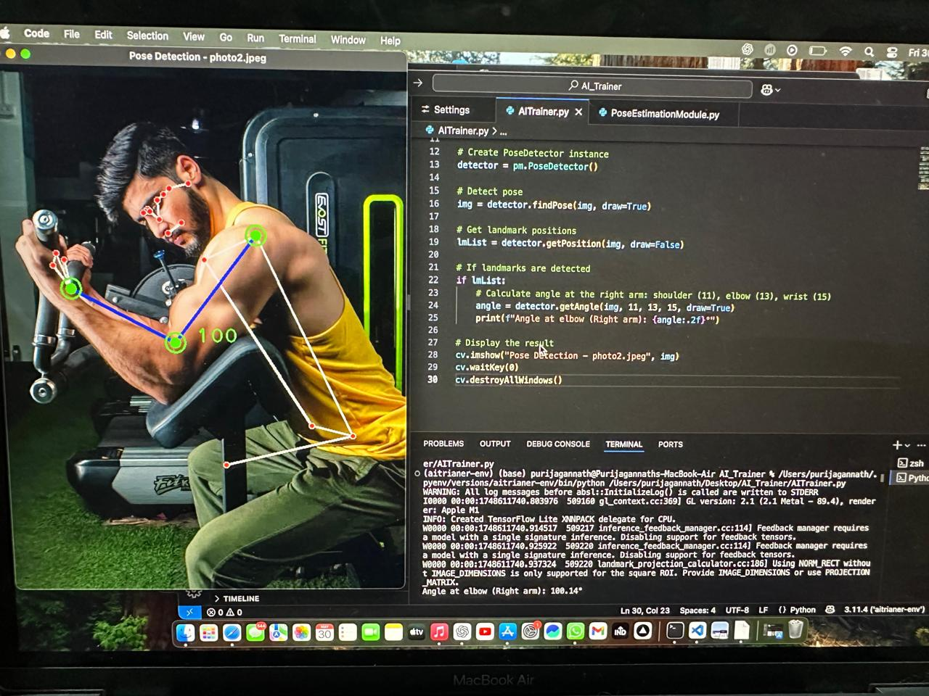
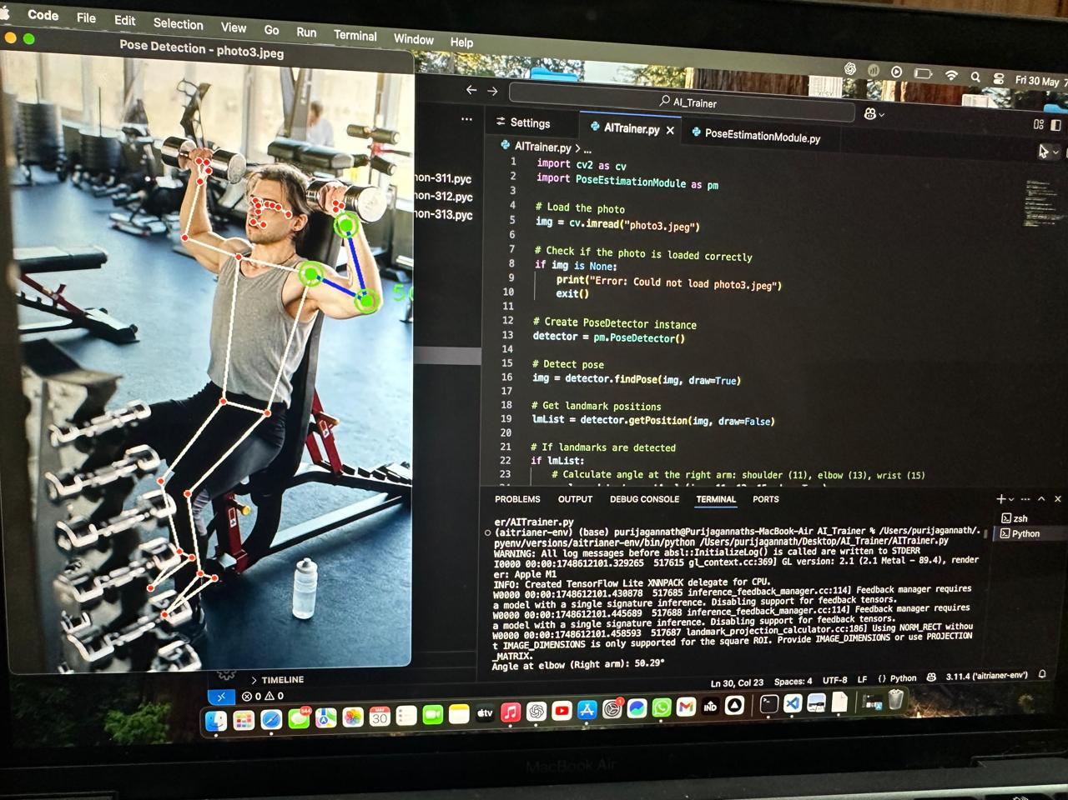
OUTPUTS

Slide 18
Conclusion
Hyper Fit AI represents the next generation of AI systems, offering tailored, high-performance solutions. Its efficiency, adaptability, and scalability make it a game-changer across industries. As technology continues to evolve, HyperFit AI stands at the forefront of smart, data-driven wellness solutions, bridging the gap between innovation and personalized health experiences.

Slide 19
Future Enhancements
Enhance Visualization with a Body Map Module Integrate a posture heatmap module that visualizes pressure points and joint alignment. This allows users to see posture deviations in real-time and supports targeted posture correction feedback.
Real-Time Alerts for Postural Deviations Enable a real-time alert system that notifies users when posture falls outside optimal alignment based on personalized thresholds. This encourages immediate corrective actions and reduces long-term strain.
Activity-Based Posture Analysis for Smarter Feedback Implement activity-aware posture categorization (e.g., sitting, standing, exercising) to enable more accurate assessments and context-specific suggestions for improvement
.

Slide 20
REFERENCES
1. Jain, A., Sharma, S., & Agrawal, R. (2020). AI-Based Fitness Tracking and Personalization Systems. International Journal of Computer Applications.
https://www.semanticscholar.org/paper/Machine-Learning-Applications-for-Precision-A-Sharma-Jain/ec9da3b5c896b67a15af062f8bca850526f2e633
2. Li, T., & Zhang, Y. (2021). Wearable Technology in Fitness and Health Monitoring: A Review. IEEE Access.
https://www.researchgate.net/publication/382878497_Integrating_Wearable_Health_Monitoring_Devices_with_IoT_for_Enhanced_Personal_Health_Management_A_Comprehensive_Review

Slide 21
THANK YOU!

